Slide 1
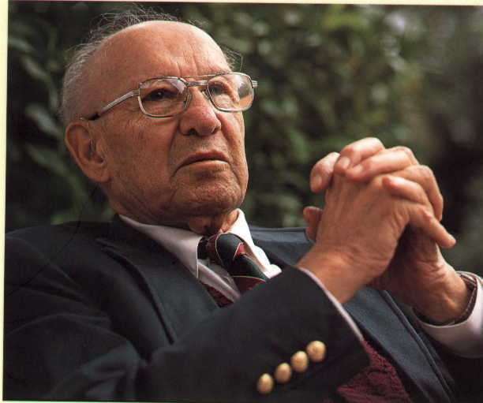
25
Management Lessons
Peter Drucker
It helps pave the way for thinking about effective management.

Slide 2
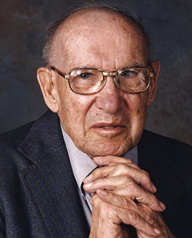
Peter Drucker – author of 35 books, Presidential Medal of Freedom winner, and still a leading voice in the business world. Peter was born in Vienna in 1909 and began working as
a financial reporter in Frankfurt, Germany, while he earned a doctoral degree in public and international law at Frankfurt University.

Slide 3
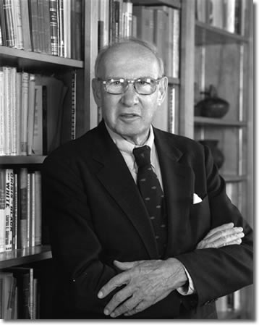
He worked as a correspondent for several British newspapers in US.
After relocating to the United State, he began working as a correspondent for several British newspapers. In 1950 he became Professor of Management at New York University, and four years later, he published "The Practice of Management," which posed three now-classic business questions: What is our business?
Who is our customer? What does
our customer consider valuable?

Slide 4
Peter Drucker was a leader in management philosophy and effectiveness. As a writer, management consultant, and social ecologist, he played an influential role in shaping key concepts around business, innovation, decision making, leadership, productivity, time management, and personal effectiveness. He first coined the term “knowledge worker” back in 1959, and helped pioneer knowledge work productivity.
Here are his 25 Life Lessons :

Slide 5
Lesson 1 : First know what’s right
First know what’s right for effective decision making. To make the right compromise, first know what right is. Don’t worry whether it’s liked, worry whether it’s right. After you know what’s right, then you can compromise.

Slide 6
Lesson 2 : Boundary conditions for effective decisions
Think of success in terms of a range or continuum of possibilities. Know the boundary conditions for your important decisions. Know what good looks like. Know the minimum the decision needs to satisfy. Don’t depend on everything going as planned. Know when you need to abandon a decision. If the decision is a failure from the start, don’t go down that path.

Slide 7
Lesson 3 : Know thy time
Time is the scarcest resource. You can’t make more time. Make the most of it. Log and analyze your time. Consider keeping lits of deadlines for urgent and unpleasant tasks. Effective people make it a habit to work at improving their time management.

Slide 8
Lesson 4 : What our business is, will be, and should be.
Don’t spend your energy defending yesterday. Instead, spend your energy exploiting today and the future. The best way to predict the future is to create it.

Slide 9
Lesson 5 : Develop disagreement rather than consensus
Don’t make a decision unless there’s disagreement. Disagreement provides alternatives, stimulates the imagination, and helps you break out of preconceived notions. Understand the alternatives. Know why people disagree. Know both sides of the issues. The most important thing in communication is hearing what isn’t said.

Slide 10
Lesson 6 : Effectiveness over universal expert.
You can’t be an expert in all things. You can round out your knowledge and get the basics, while still specializing in a few areas.

Slide 11
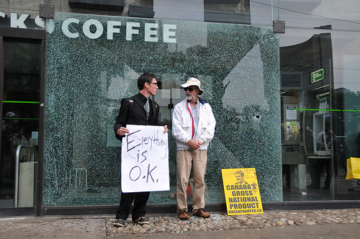
Lesson 7 : Focus on the customer
The primary function of a business is to serve the customer and the primary goal of your business is to create customers. The aim of marketing is to know and understand the customer so well the product or service fits him and sells itself.

Slide 12
Lesson 8 : Manage by objectives
Set the goals and get out of the way. Help unblock people, enable and empower people to reach the goals. Avoid the how trap. Management by objective works – if you know the objectives. Ninety percent of the time you don’t.

Slide 13
Lesson 9 : Planned abandonment
Plan an ending. Determine how long the commitment will be for, and create some boundaries around it. If you won’t have enough time to finish it, don’t take it on. Build in a review mechanism so you can determine whether to continue or change course or stop. When you stop something, you make room for something else.

Slide 14
Lesson 10 : Productivity objectives
Results are the best way to compare effectiveness. Quality of management is a key differentiator. Focus on continuous productivity improvement. The productivity of work is not the responsibility of the worker but of the manager.

Slide 15
Lesson 11 : Innovation Objectives
Innovation is how you grow your business. The key challenge with innovation objectives is measuring relative impact and importance. According to Drucker, there are 3 kinds of innovation: 1) process, 2) product, and 3) market.

Slide 16
Lesson 12 : Resource objectives
Your business needs to attract land, labor and capital. Your jobs have to satisfy the business and the people in the market. The first sign of decline is loss of attraction to qualified, ambitious people. Design jobs to attract and retain the kind of people you want.

Slide 17
Lesson 13 : Social responsibility objectives
Bake social objectives into your strategy. Society and the economy need to believe that your business serves a necessary, useful and productive job. Think through your social and economic impact and responsibilities.

Slide 18
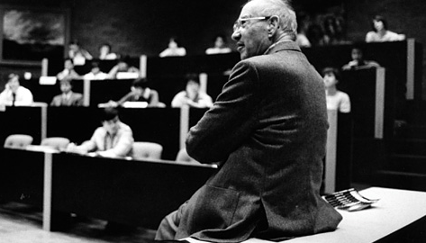
Lesson 14 : Leadership is defined by results only
Effective leadership is not about making speeches or being liked; leadership is defined by results not attributes. Management is doing things right; leadership is doing the right things.

Slide 19
Lesson 15 : Opinions over facts
Know that decisions are judgments. Start with opinions over facts. Know the criteria of what’s relevant. Test your opinions against reality. Making good decisions is a crucial skill at every level.

Slide 20
Lesson 16 : Effectiveness over efficiency
Efficiency is doing things right; effectiveness is doing the right things. Follow effective action with quiet reflection. From the quiet reflection will come even more effective action.

Slide 21
Lesson 17 : Importance of Knowledge
Knowledge has to be improved, challenged, and increased constantly, or it vanishes.

Slide 22
Lesson 18 : Employees are assets
Employees are assets not liabilities. Most of what we call management consists of making it difficult for people to get their work done.

Slide 23
Lesson 19 : How much profit do you really need to make?
Know the minimum profitability you need to survive. Know the minimum might be higher than you expected. Plan for minimum profitability over profit maximization.

Slide 24
Lesson 20 : 5 bad entrepreneurial habits
The 5 bad entrepreneurial habits are: 1) Not invented here 2) Creaming 3) Quality
4) Premium price 5) Maximize rather than optimize.

Slide 25
Lesson 21 : Non-profits provide fulfillment
When you can’t find fulfillment at work, you might find it by volunteering for a non-profit.

Slide 26
Lesson 22 : Learning is a lifelong process
We now accept the fact that learning is a lifelong process of keeping abreast of change. And the most pressing task is to teach people how to learn.

Slide 27
Lesson 23 : No plan means no commitment
Unless commitment is made, there are only promises and hopes… but no plans.

Slide 28
Lesson 24 : Of those things, which are right for me?
“Successful leaders don't start out asking, "What do I want to do?" They ask, "What needs to be done?" Then they ask, "Of those things that would make a difference, which are right for me?”

Slide 29
Lesson 25 : Service to others
Business should contribute to society and to the greater good.

Slide 30
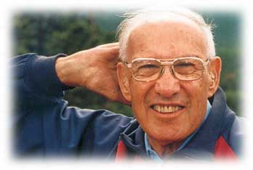
Peter Drucker has added significance to the lives of many people over the span of decades and for that we are grateful. The world has lost a great man, but I suspect that Heaven will become a more efficient place as a result!
Thank You Very Much
Sompong Yusoontorn

